Slide 2

Azure Service Fabric for Developers
B874
Jeffrey Richter
software engineer
Mark Fussell
program manager
Microsoft Azure
Service Fabric

Slide 3




Why a microservices approach?
Continually evolving applications
Faster delivery of features and capabilities to respond to customer expectations
Build and operate a service at scale
1
4
Monitor + Learn
Plan
Development
Production
2
3
Release
Develop + Test
Notes:
Read the following overviews
https://azure.microsoft.com/en-us/documentation/articles/service-fabric-overview-microservices/
MSDN Article on Service Fabric https://msdn.microsoft.com/en-us/magazine/mt595752
Watch this video https://channel9.msdn.com/Events/Visual-Studio/Connect-event-2015/911
Gartner Definition of Cloud-Native Applications
This use case includes applications at any scale, which have been written with the strengths and weaknesses of public cloud IaaS in mind. Cloud-native applications assume that resilience must reside in the application and not in the infrastructure (low "compute resilience" weighting), that the application can run well in a variety of underlying infrastructure configurations (low "architecture flexibility" weighting), that the customer's IT organization will attend to security concerns (low "security and compliance" weighting), and that there are only minimal integrations with existing on-premises infrastructure and applications (low "enterprise integration" weighting). Automation, API capabilities and scale-out capabilities are, however, extremely important. Because many such applications have big data aspects, the big data enablement capability also receives a high weighting in this use case

Slide 4


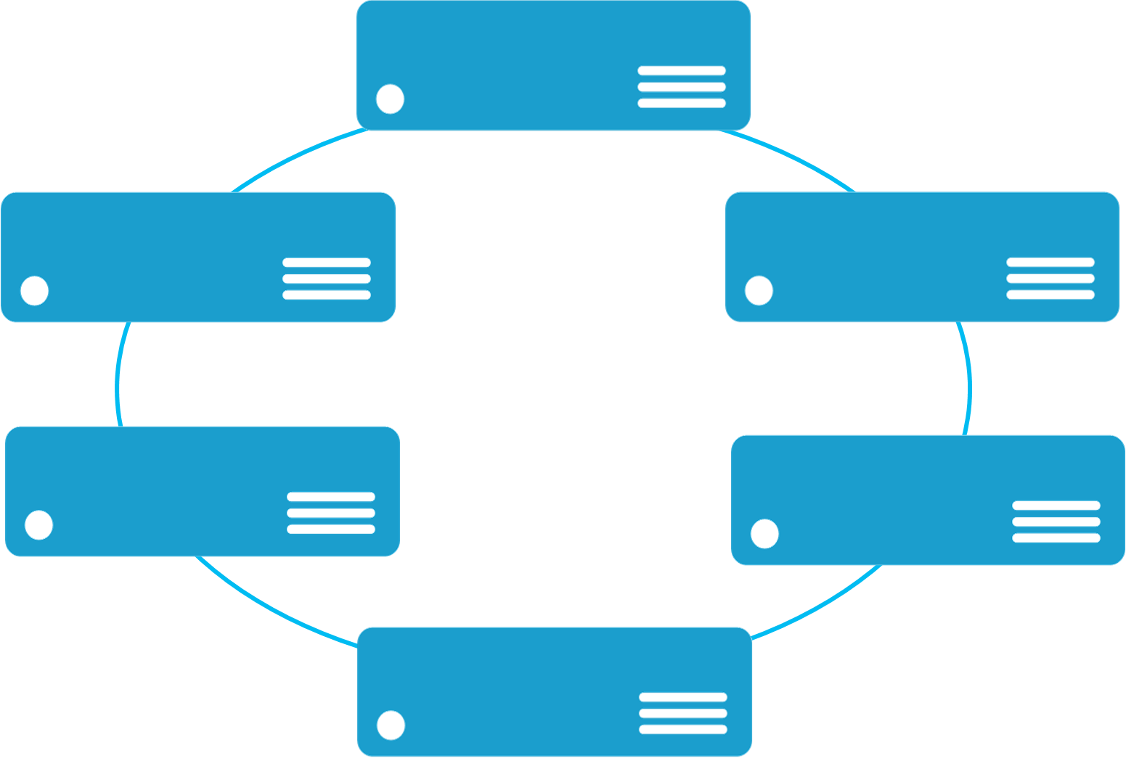


Monolithic application approach
Microservices application approach
A monolith app contains domain specific functionality and is normally divided by functional layers such as web, business and data
App 1
App 1
App 2
A microservice application separates functionality into separate smaller services.
Scales by cloning the app on multiple servers/VMs/Containers
Scales out by deploying each service independently creating instances of these services across servers/VMs/containers

Slide 5
Microservices
Build Applications with many Programming Frameworks and Languages
Microservices Platform
Deploy and Manage Applications to many Environments

Slide 6
Azure Service Fabric
LifecycleMgmt
Independent Scaling
Independent Updates
Always On Availability
Resource Efficient
Stateless/
Stateful
Public Cloud
On Premises
Private cloud
Other Clouds

Slide 7

Service Fabric Cluster
Datacenter (Azure, On Premises, Other Clouds )
PC/VM #2
Service Fabric
Your code, etc.
PC/VM #3
Management to deploy your code, etc. (Port: 19080)
Service Fabric
PC/VM #1
Your code, etc.
Service Fabric
PC/VM #4
Load Balancer
Your code, etc.
Service Fabric
Your code, etc.
PC/VM #5
App Web Request (Port: 80/443/?)
Service Fabric
Your code, etc.
Notes:
Box representing cloud
Contains Cluster (can contain 1000s of nodes)
Contains Nodes (@ has name)
Endpoints
HttpGateWay (19007), Cluster (tcp: 19000)?
Your “static” code/data/config
Load Balancer
Animate: start w/DC box
Enter some nodes (names)
Install OS/SF
Establish endpoints to create cluster
You code/data/config
Load Balancer
Client request → LB → to a node
---
<?xml version="1.0" encoding="utf-8"?>
<!--
WARNING WARNING WARNING WARNING WARNING WARNING WARNING WARNING WARNING WARNING WARNING
WARNING WARNING WARNING WARNING WARNING WARNING WARNING WARNING WARNING WARNING WARNING
WARNING WARNING WARNING WARNING WARNING WARNING WARNING WARNING WARNING WARNING WARNING
The settings used within this ClusterManifest are expressly for use only
within a developer single-box environment. Any use of these settings outside
of that environment are highly likely to produce incorrect, and misperforming
systems.
WARNING WARNING WARNING WARNING WARNING WARNING WARNING WARNING WARNING WARNING WARNING
WARNING WARNING WARNING WARNING WARNING WARNING WARNING WARNING WARNING WARNING WARNING
WARNING WARNING WARNING WARNING WARNING WARNING WARNING WARNING WARNING WARNING WARNING
-->
<ClusterManifest
xmlns:xsd="http://www.w3.org/2001/XMLSchema"
xmlns:xsi="http://www.w3.org/2001/XMLSchema-instance"
xmlns="http://schemas.microsoft.com/2011/01/fabric"
Name="ComputerName-Local-Cluster"
Version="1.0">
<NodeTypes>
<NodeType Name="NodeType1">
<Endpoints>
<ClientConnectionEndpoint Port="19000" />
<LeaseDriverEndpoint Port="19001" />
<ClusterConnectionEndpoint Port="19002" />
<HttpGatewayEndpoint Port="19007" Protocol="http" />
<ServiceConnectionEndpoint Port="19006" />
<ApplicationEndpoints StartPort="30001" EndPort="31000" />
</Endpoints>
</NodeType>
<NodeType Name="NodeType2">
<Endpoints>
<ClientConnectionEndpoint Port="19010" />
<LeaseDriverEndpoint Port="19011" />
<ClusterConnectionEndpoint Port="19012" />
<HttpGatewayEndpoint Port="19017" Protocol="http" />
<ServiceConnectionEndpoint Port="19016" />
<ApplicationEndpoints StartPort="31001" EndPort="32000" />
</Endpoints>
</NodeType>
<NodeType Name="NodeType3">
<Endpoints>
<ClientConnectionEndpoint Port="19020" />
<LeaseDriverEndpoint Port="19021" />
<ClusterConnectionEndpoint Port="19022" />
<HttpGatewayEndpoint Port="19027" Protocol="http" />
<ServiceConnectionEndpoint Port="19026" />
<ApplicationEndpoints StartPort="32001" EndPort="33000" />
</Endpoints>
</NodeType>
<NodeType Name="NodeType4">
<Endpoints>
<ClientConnectionEndpoint Port="19030" />
<LeaseDriverEndpoint Port="19031" />
<ClusterConnectionEndpoint Port="19032" />
<HttpGatewayEndpoint Port="19037" Protocol="http" />
<ServiceConnectionEndpoint Port="19036" />
<ApplicationEndpoints StartPort="33001" EndPort="34000" />
</Endpoints>
</NodeType>
<NodeType Name="NodeType5">
<Endpoints>
<ClientConnectionEndpoint Port="19040" />
<LeaseDriverEndpoint Port="19041" />
<ClusterConnectionEndpoint Port="19042" />
<HttpGatewayEndpoint Port="19047" Protocol="http" />
<ServiceConnectionEndpoint Port="19046" />
<ApplicationEndpoints StartPort="34001" EndPort="35000" />
</Endpoints>
</NodeType>
</NodeTypes>
<Infrastructure>
<WindowsServer IsScaleMin="true">
<NodeList>
<Node NodeName="Node.1" IPAddressOrFQDN="localhost" IsSeedNode="true" NodeTypeRef="NodeType1" FaultDomain="fd:/FD01" UpgradeDomain="UD1" />
<Node NodeName="Node.2" IPAddressOrFQDN="localhost" IsSeedNode="true" NodeTypeRef="NodeType2" FaultDomain="fd:/FD02" UpgradeDomain="UD2" />
<Node NodeName="Node.3" IPAddressOrFQDN="localhost" IsSeedNode="true" NodeTypeRef="NodeType3" FaultDomain="fd:/FD03" UpgradeDomain="UD3" />
<Node NodeName="Node.4" IPAddressOrFQDN="localhost" IsSeedNode="false" NodeTypeRef="NodeType4" FaultDomain="fd:/FD04" UpgradeDomain="UD1" />
<Node NodeName="Node.5" IPAddressOrFQDN="localhost" IsSeedNode="false" NodeTypeRef="NodeType5" FaultDomain="fd:/FD05" UpgradeDomain="UD2" />
</NodeList>
</WindowsServer>
</Infrastructure>
<FabricSettings>
<Section Name="Security">
<Parameter Name="ClusterCredentialType" Value="None" />
<Parameter Name="ServerAuthCredentialType" Value="None" />
</Section>
<Section Name="FailoverManager">
<!-- expected cluster size allows the placement to start when the cluster is started. This value should be less than total number of nodes
as without it the FailoverManager will not start the placement of the user services. This value should be 80% to 90% of the cluster size.
-->
<Parameter Name="ExpectedClusterSize" Value="4" />
<!-- The default target and min replica set sizes are 7 and 5. The below configuration is not required for cluster that have 7 or more nodes. -->
<Parameter Name="TargetReplicaSetSize" Value="5" />
<Parameter Name="MinReplicaSetSize" Value="3" />
<Parameter Name="ReconfigurationTimeLimit" Value="20" />
<Parameter Name="BuildReplicaTimeLimit" Value="20" />
<Parameter Name="CreateInstanceTimeLimit" Value="20" />
<Parameter Name="PlacementTimeLimit" Value="20" />
</Section>
<Section Name="ReconfigurationAgent">
<Parameter Name="ServiceApiHealthDuration" Value="20" />
<Parameter Name="ServiceReconfigurationApiHealthDuration" Value="20" />
<Parameter Name="LocalHealthReportingTimerInterval" Value="5" />
<Parameter Name="IsDeactivationInfoEnabled" Value="true" />
</Section>
<Section Name="ClusterManager">
<!-- The default target and min replica set sizes are 7 and 5. The below configuration is not required for cluster that have 7 or more nodes. -->
<Parameter Name="TargetReplicaSetSize" Value="5" />
<Parameter Name="MinReplicaSetSize" Value="3" />
<Parameter Name="UpgradeStatusPollInterval" Value="5" />
<Parameter Name="UpgradeHealthCheckInterval" Value="5" />
<Parameter Name="FabricUpgradeHealthCheckInterval" Value="5" />
</Section>
<Section Name="NamingService">
<!-- The default target and min replica set sizes are 7 and 5. The below configuration is not required for cluster that have 7 or more nodes. -->
<Parameter Name="TargetReplicaSetSize" Value="5" />
<Parameter Name="MinReplicaSetSize" Value="3" />
</Section>
<Section Name="Management">
<Parameter Name="ImageStoreConnectionString" Value="file:C:\SfDevCluster\Data\ImageStore" />
<Parameter Name="ImageCachingEnabled" Value="false" />
</Section>
<Section Name="Hosting">
<Parameter Name="EndpointProviderEnabled" Value="true" />
<Parameter Name="RunAsPolicyEnabled" Value="true" />
<Parameter Name="DeactivationScanInterval" Value="60" />
<Parameter Name="DeactivationGraceInterval" Value="10" />
<Parameter Name="EnableProcessDebugging" Value="true" />
<Parameter Name="ServiceTypeRegistrationTimeout" Value="20" />
<Parameter Name="CacheCleanupScanInterval" Value="300" />
</Section>
<Section Name="HttpGateway">
<Parameter Name="IsEnabled" Value="true" />
</Section>
<Section Name="PlacementAndLoadBalancing">
<!-- balance the load on the cluster every 5 minutes. -->
<Parameter Name="MinLoadBalancingInterval" Value="300" />
</Section>
<Section Name="Federation">
<Parameter Name="NodeIdGeneratorVersion" Value="V3" />
</Section>
<Section Name="Trace/Etw">
<Parameter Name="Level" Value="4" />
</Section>
<!-- Configure the DCA to cleanup the log folder only. The collection of the logs, performance counters and crashdumps is not performed on the local machine. -->
<Section Name="Diagnostics">
<Parameter Name="ProducerInstances" Value="ServiceFabricEtlFile, ServiceFabricPerfCtrFolder" />
<Parameter Name="MaxDiskQuotaInMB" Value="10240" />
</Section>
<Section Name="ServiceFabricEtlFile">
<Parameter Name="ProducerType" Value="EtlFileProducer" />
<Parameter Name="IsEnabled" Value="true" />
<Parameter Name="EtlReadIntervalInMinutes" Value=" 5" />
<Parameter Name="DataDeletionAgeInDays" Value="3" />
</Section>
<Section Name="ServiceFabricPerfCtrFolder">
<Parameter Name="ProducerType" Value="FolderProducer" />
<Parameter Name="IsEnabled" Value="true" />
<Parameter Name="FolderType" Value="WindowsFabricPerformanceCounters" />
<Parameter Name="DataDeletionAgeInDays" Value="3" />
</Section>
<Section Name="TransactionalReplicator">
<Parameter Name="MaxStreamSizeInMB" Value="64" />
</Section>
</FabricSettings>
</ClusterManifest>

Slide 8
Service Fabric Auction App
Microservices design
Application Type: sfAuction
Service Type: Website Guest Executable (stateless) (Node.js)
Service Type: APIGateway Reliable Service (stateless) (C#/.NET)
Service Type: Auction Reliable Collections (stateful) (C#/.NET)

Slide 9
Demo
SF Auction
Visual Studio Solution

Slide 10
Action App in Azure
Cluster
VMSS #1 (stateless tier) NodeType=“FrontEnd”
VMSS #2 (stateful tier) NodeType=“BackEnd”
Node #1
Node #3
Website
Auction
Load Balancer
ApiGateway
Node #2
Node #4
Website
Auction
ApiGateway

Slide 11
Demo
Creating Service Fabric Clusters Anywhere
Notes:
Auction Code location https://onedrive.live.com/?authkey=%21ADHHuNlqF8fFHU8&id=6341E7E7F1ED07B2%21402049&cid=6341E7E7F1ED07B2
Azure 1
mfussellbld2016-3.eastus.cloudapp.azure.com
Explorer - http://mfussellbld2016-3.eastus.cloudapp.azure.com:19080/Explorer/index.html#/
Auction - http://mfussellbld2016-3.eastus.cloudapp.azure.com:8080/
http://mfussellbld2016-3.eastus.cloudapp.azure.com:8081/visualobjects/
Azure 1.1 Secure
Explorer - https://build2016-sfdemo.eastus.cloudapp.azure.com:19080/Explorer/index.html#/
Auction - http://build2016-sfdemo-frontend.eastus.cloudapp.azure.com:8082/
AWS 1
ec2-52-24-157-184.us-west-2.compute.amazonaws.com
Explorer - http://ec2-52-24-157-184.us-west-2.compute.amazonaws.com:19080/Explorer/index.html#/
Auction - http://ec2-52-24-157-184.us-west-2.compute.amazonaws.com:8080/
Visual Objects - http://ec2-52-24-157-184.us-west-2.compute.amazonaws.com:8081/visualobjects/
To remove Auction App
Get-ServiceFabricNode | Get-ServiceFabricDeployedReplica -ApplicationName fabric:/SFAuction | Remove-ServiceFabricReplica -ForceRemove
Linux
http://13.90.250.75
PTTY to IP mani with pswd: SF-linux4
ps aux | grep fabric - to show fabric running
http://13.90.250.75:19080/Explorer
azuresfcli servicefabric cluster connect http://localhost:19080
azuresfcli servicefabric node show
or
sf node show
Azure 2
Explorer - http://mfussell-bld4.eastus.cloudapp.azure.com:19080/Explorer/index.html#/
Auction - http://mfussell-bld4.eastus.cloudapp.azure.com:8080/
//Secure Cluster with AAD. Shows Front End and Backend nodes
build2016-sfdemo.northcentralus.cloudapp.azure.com
Explorer - https://build2016-sfdemo.northcentralus.cloudapp.azure.com:19080/Explorer/index.html#/
AWS 2 - ec2-52-37-108-103.us-west-2.compute.amazonaws.com
Service Fabric Explorer - http://ec2-52-37-108-103.us-west-2.compute.amazonaws.com:19080/Explorer
Visual Objects - http://ec2-52-37-108-103.us-west-2.compute.amazonaws.com:8081/visualobjects
Auction - http://ec2-52-37-108-103.us-west-2.compute.amazonaws.com:8080/

Slide 12
Service Fabric Platform Capabilities
All code and programming models
Fast deployment
Placement and activation
Reliability
High density
Health reporting
Coordinated upgrades
Service Type: Website Guest Executable (stateless) (Node.js)

Slide 13
Website Guest Executable & Dockers Containers ServiceManifest.xml
<ServiceManifest Name="Pkg-Svc.Website" Version="1.0.0" …>
<ServiceTypes>
<StatelessServiceType ServiceTypeName="Svc.WebsiteType" UseImplicitHost="true"/>
</ServiceTypes>
<CodePackage Name="Code" Version="1.0.0">
<EntryPoint>
<ExeHost>
<Program>node.exe</Program>
<Arguments>Server.js</Arguments>
</ExeHost>
</EntryPoint>
</CodePackage>
</ServiceManifest>
<ContainerHost>
<ImageName>myNodeImage:latest</ImageName>
<Commands></Commands>
</ContainerHost>

Slide 14
Service Fabric Platform Capabilities
All code and programming models
Fast deployment
Placement and activation
Reliability
High density
Health reporting
Coordinated upgrades
Reliable Services programming model
Service endpoint discovery
Dynamic resource balancing based on actual resource usage
Integrated application patterns e.g. Actor pattern and WebApi
Visual Studio development e.g. F5 debugging, diagnostics events, package and deploy
Service Type: Website Guest Executable (stateless) (Node.js)
Service Type: APIGateway Reliable Service (stateless) (C#/.NET)

Slide 15
Demo
SF Auction APIGateway Reliable Services (stateless)

Slide 16


State Architectures: Traditional vs Service Fabric
Stateless Web
Stateless Compute
Cache
Stateful Data
Other Internal Tiers ?
Load Balancer
Stateless Web
Stateful Compute
Load Balancer

Slide 17
Service Fabric Platform Capabilities
All code and programming models
Fast deployment
Placement and activation
Reliability
High density
Health reporting
Coordinated upgrades
Reliable Services programming model
Service endpoint discovery
Dynamic resource balancing based on actual resource usage
Integrated application patterns e.g. Actor pattern and WebApi
Visual Studio development e.g. F5 debugging, diagnostics events, package and deploy
Reliable Collections programming model
Highly-reliable and scalable state
Lower latency compared to external storage
Service Type: Website Guest Executable (stateless) (Node.js)
Service Type: APIGateway Reliable Service (stateless) (C#/.NET)
Service Type: Auction Reliable Collections (stateful) (C#/.NET)

Slide 18
Stateful Auction Service
Auction (Partition #1)
Users Dictionary
Email | UserInfo
U1 | ItemId[]
U2 | ItemId[]
U1’s Items Dictionary
ItemId | ItemInfo
U1/“A” | 2016-2-1, Bid[]
U1/“B” | 2016-2-5, Bid[]
CreateUserAsync
APIGateway
Active Items List
ItemId
U1/“A”
U2/“X”
U2’s Items Dictionary
ItemId | ItemInfo
U2/“X” | 2016-3-3, Bid[]
U2/”Y” | 2016-4-9, Bid[]

Slide 19
Demo
SF Auction
Reliable Collections (stateful)

Slide 20




















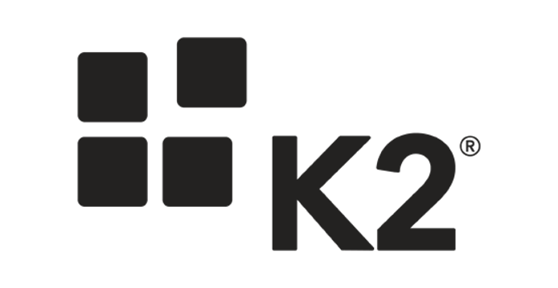










































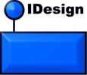










Slide 21

















Slide 22


Age of Ascent & Service Fabric
Ben Adams
CTO
Independent games studio specializing in massively multiplayer games

Slide 23
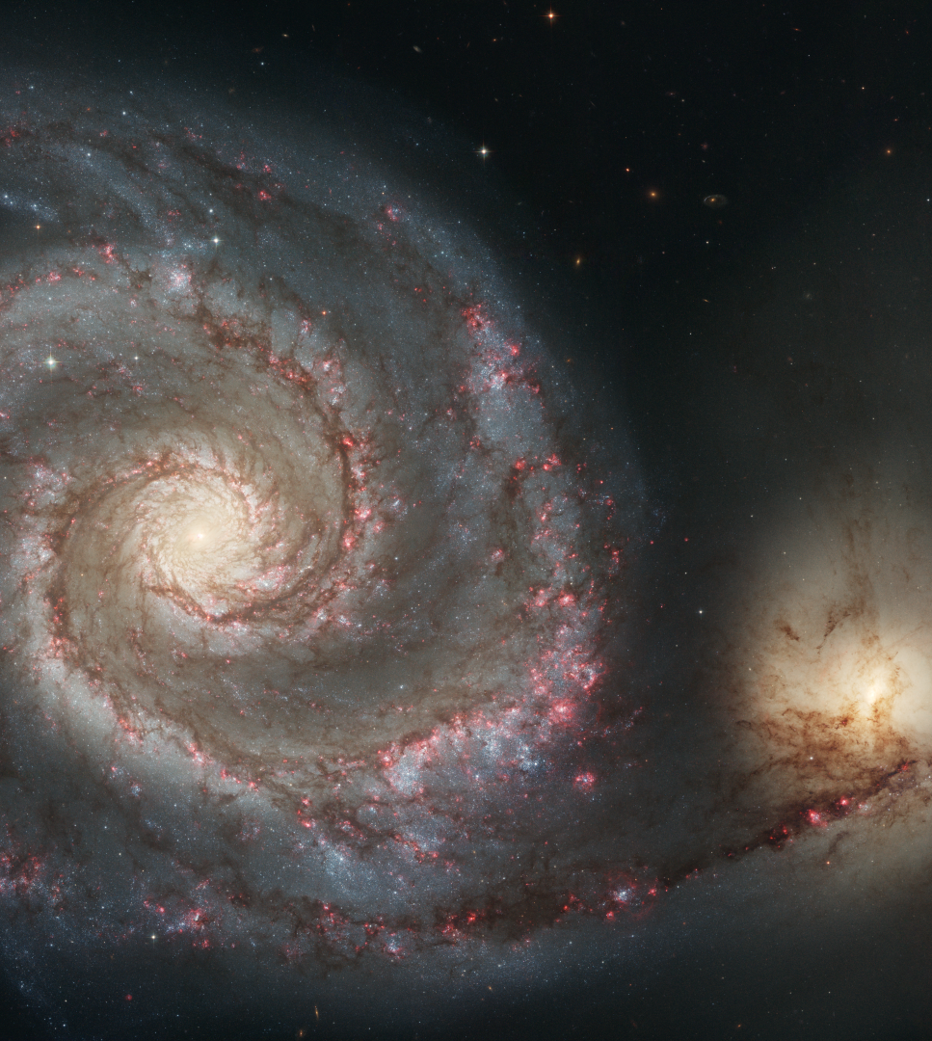

Ultra Massively Multiplayer Game
Driven by human interaction
A single contiguous universe
Without artificial boundaries
Credit: NASA, ESA, S. Beckwith (STScI), and The Hubble Heritage Team (STScI/AURA)
Notes:
Photo source: http://hubblesite.org/newscenter/archive/releases/2005/12/image/a/

Slide 24
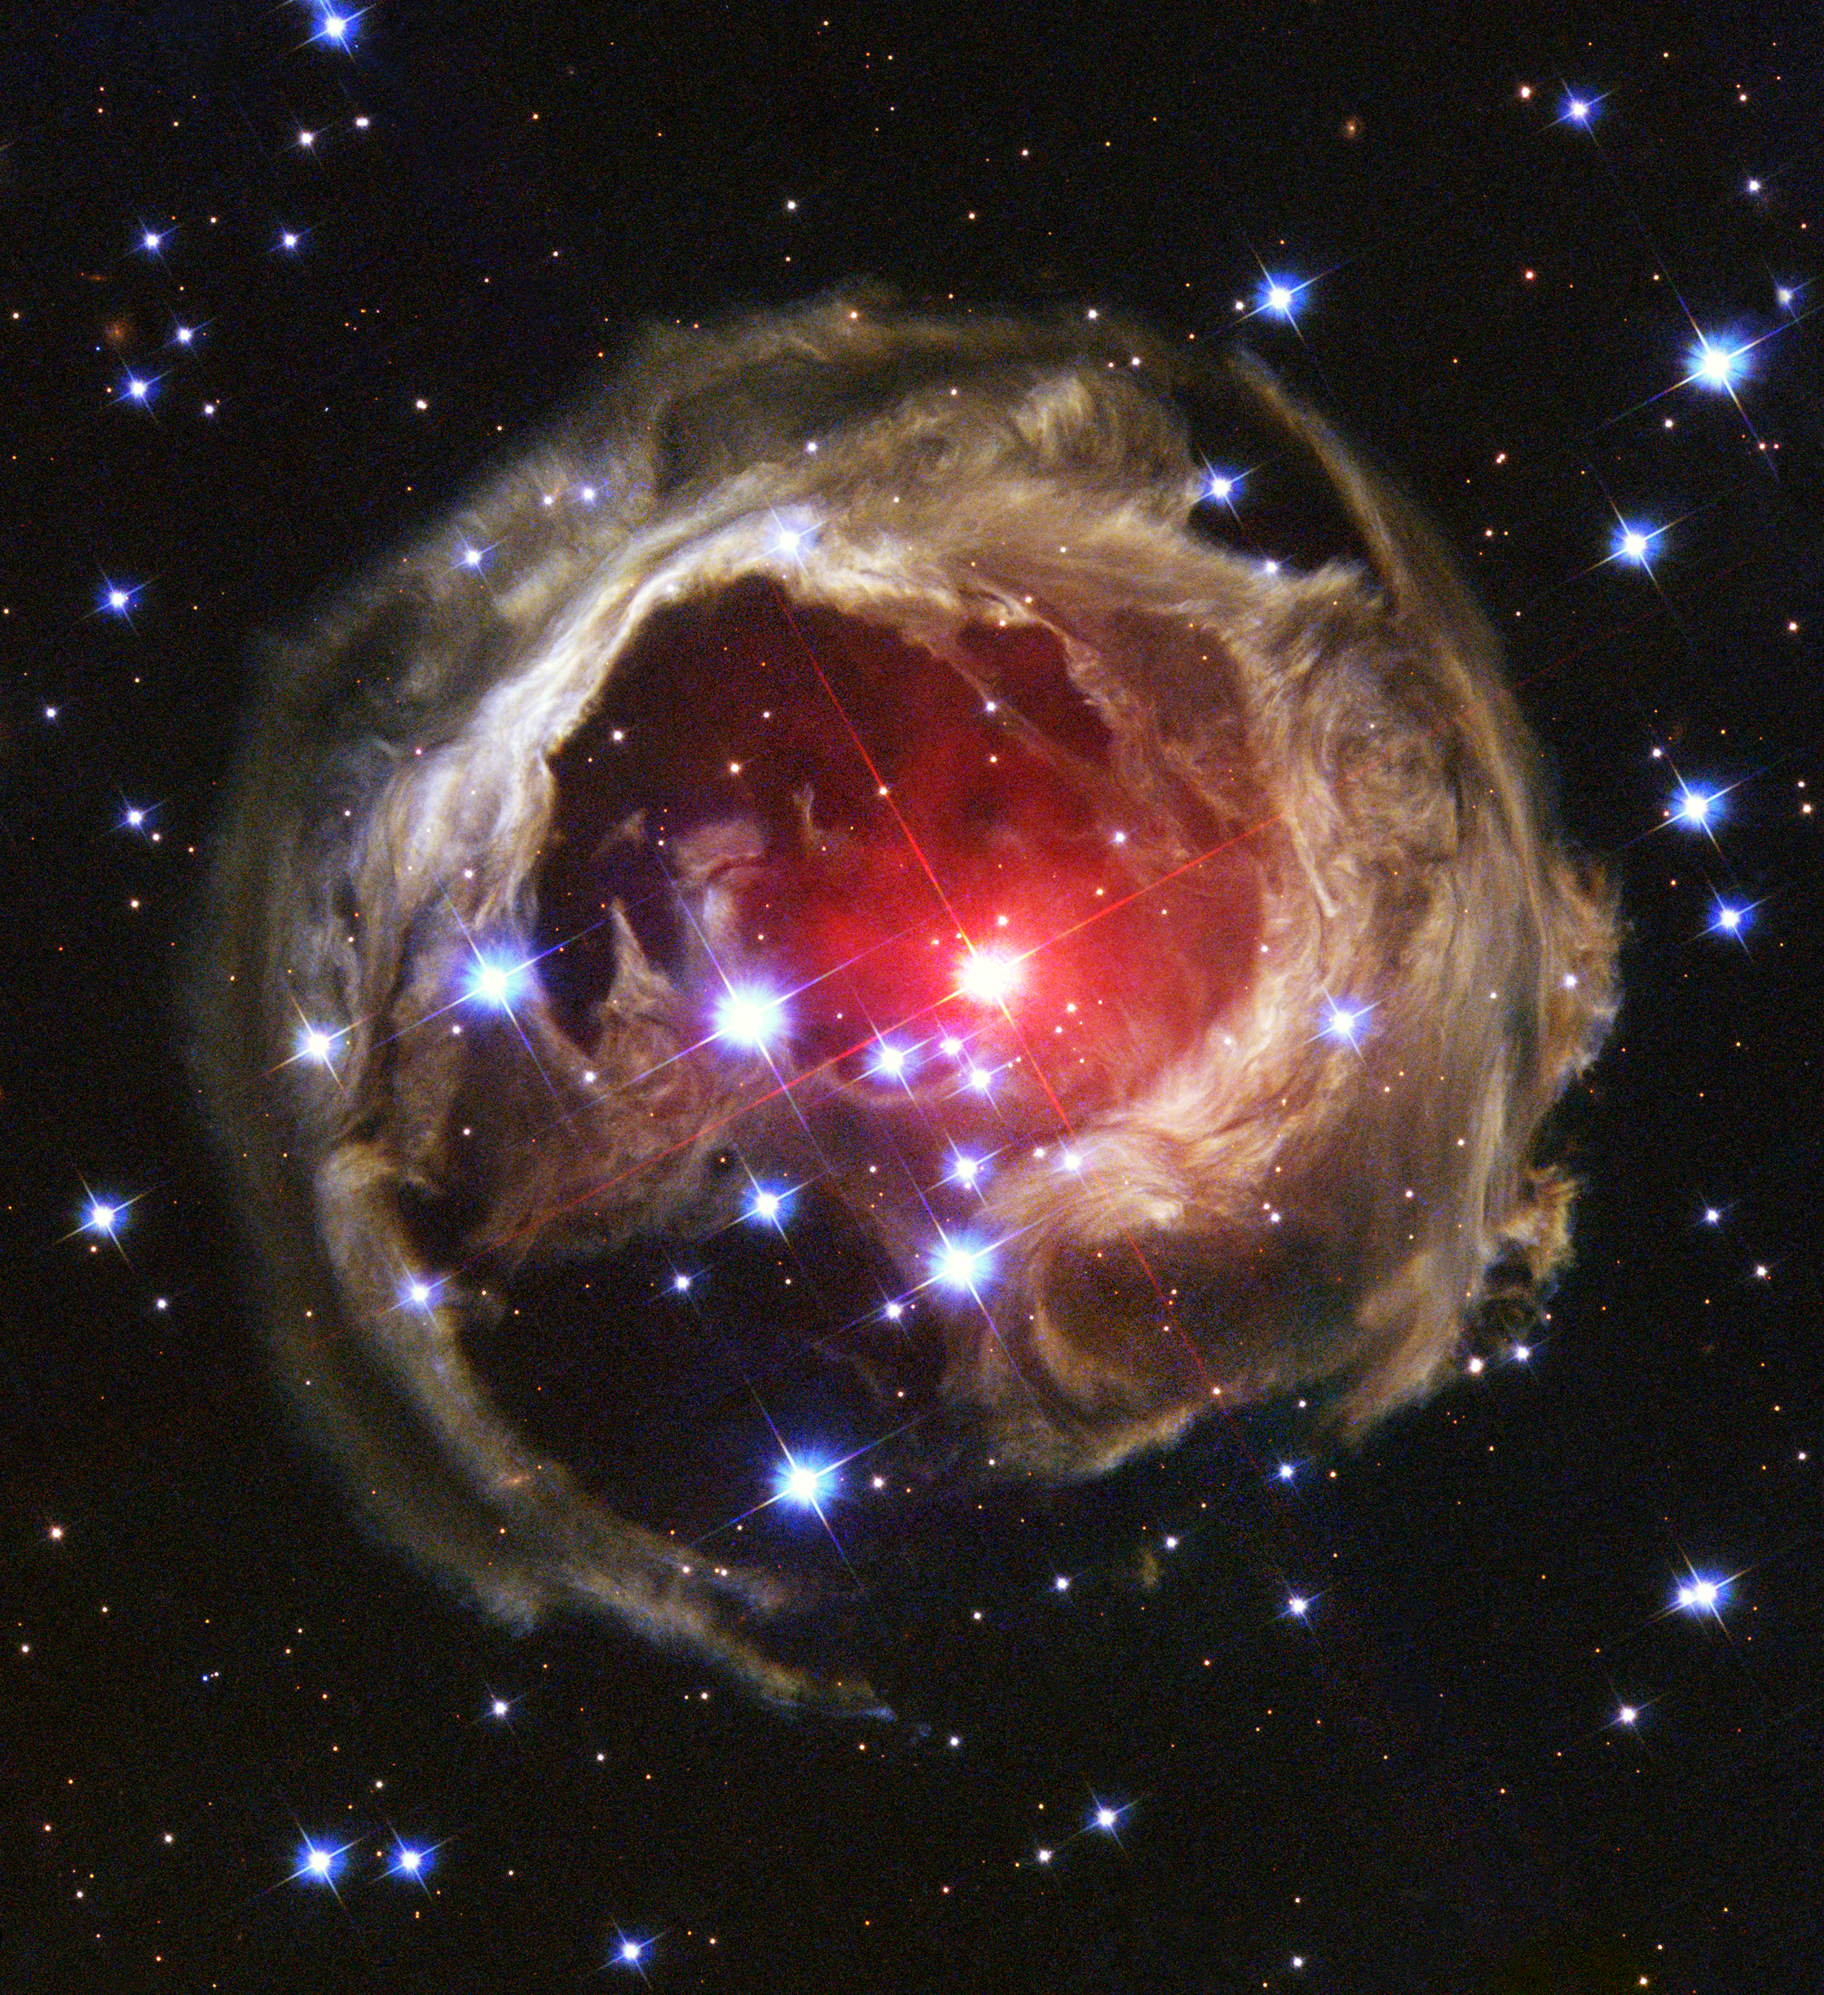
Born in the cloud
Servers are a resource
Hyper scale
High density
Cost effective
Unanticipated load handling
Fault tolerant
Seamless user experience
Always available
Individually upgradable
Data scales with compute
Credit: NASA and The Hubble Heritage Team (AURA/STScI)
Notes:
Photo source: https://www.flickr.com/photos/gsfc/4399421610

Slide 25

High Performance
Empire building, economic price wars, real-time space twitch-combat.
Millions of players concurrently in single contiguous universe.
50,000+ simultaneous players, real-time in the same battle.
267 million networked application messages per second. (23 trillion per day)
Credit: ESO/L. Calçada
Notes:
Photo source: http://www.nasa.gov/mission_pages/spitzer/multimedia/pia13275.html

Slide 26


web browser
or device
Age of Ascent Architecture
CDN
Service Fabric Cluster
Gaia (stateless)
Avatar
(stateless)
32 Microservices
AI
Events
routing
services
physics
service
Account
Player
Commerce
Crew
Alliance
aggregate
services
game
function
services
Spatial
(In Space)
Trade Inventory Production
Navigation
Comms

Slide 27
Demo
Age of Ascent – Service Fabric
Notes:
Show VS project, relate to arch diagram
Show 40 node cluster in Azure SFX

Slide 28
Call to Action
Come to the product booth and chat with the team
Download the Service Fabric developer SDK
http://aka.ms/ServiceFabricSDK
Download the standalone Service Fabric preview for Windows Server
http://aka.ms/ServiceFabricWS2012R2
Learn from samples and complete solutions
http://aka.ms/ServiceFabricSamples
Signup for Service Fabric on Linux
http://aka.ms/SFlinuxpreview
Provide feedback
http://aka.ms/ServiceFabricForum
Twitter HashTag
#AzureServiceFabric

Slide 29
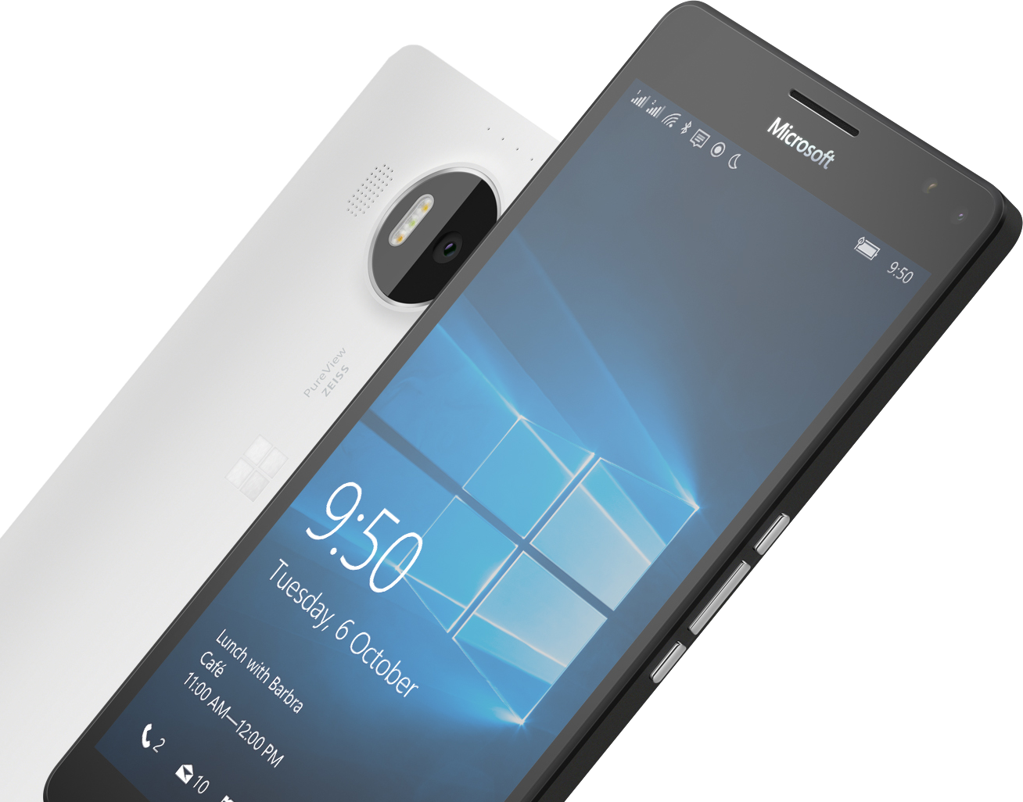


Please Complete An Evaluation Form Your input is important!
Required Slide
*delete this box when your slide is finalized
SAMPLE
or
Notes:
Update phone image to a Microsoft phone.

